Slide 1
A Brief History of Neural Network Field
Jose C. Principe, Ph.D.
Distinguished Professor of ECE
Eckis Professor,
University of Florida, Gainesville
principe@cnel.ufl.edu
Disclaimer: All pictures where downloaded from publicly available websites

Slide 2
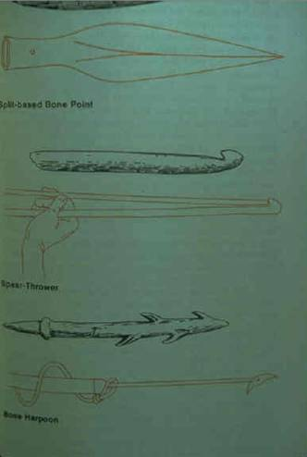
Humans and their Impressive Technologies
Mostly a Master-Slave Relationship
Trend is towards Brain Centric Technologies
Intel i7 Core ~ 1.4 billion transistors

Slide 3
Our Technology World is Impressive
Burj Khalifa in Dubai, United Arab Emirates
world's tallest man-made structure is 829.8 m (2,722 ft) tall

Slide 4
Our Technology World is Impressive
Amazon.com Distribution Centers

Slide 5
Our Technology World is Impressive
Facebook data center Lulea, Sweden (Artic Circle)~ 300 million US$
Facebook process 350 million photographs, 4.5 billion “likes,”
and 10 billion messages a day. Refrigeration power ratio 3--> 1.04

Slide 6
Our Technology World is Impressive
US National Ignition Facility, Lawrence Livermore Labs
total energy is amplified 10¹⁸ from 1 billionth of a joule to 4 million joules
—all in a few millionths of a second

Slide 7
Our Technology World is Impressive
Robotic Surgery and the new medical Diagnostics

Slide 8
Our Technology World is Impressive
Brain Computer Interfaces to help the disabled

Slide 9
Trend to Brain Centric Technologies
Our brain is an internal representation system.
Life in society is difficult because requires brain to brain communication
Throughout history we invented ways of copying with this problem: culture, language, books, and now the web repositories.
AI is going to bridge brains and create an external intelligent society to facilitate access and diffusion of information amongst humans.
This will drastically accelerate changes in the way we live and organize society.

Slide 10
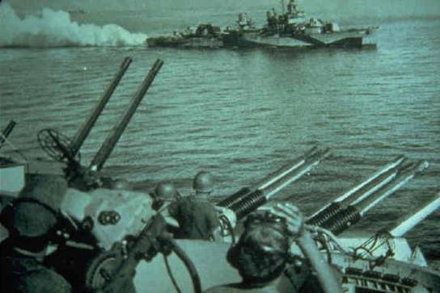
Master Slave Tools: The Dawn of a New Era
The anti-aircraft fire control 1941
Machine could automatically track a target and predict
its position in the future (Norbert Wiener/Julian Bigelow)

Slide 11
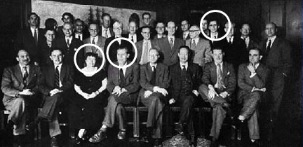
After The War… Josiah Macy Foundation Meetings (1946-53)
Participants:
McCulloch (Chair)
Wiener
Von Neumann
Pitts
Shannon
Margaret Mead
Ideas from:
Living organisms
Control and communication devices
Human society
Focus on:
Information, feedback, control= cybernetics

Slide 12
Warren McCulloch Neurophysiologist (1943)
Implementation of Turing Machines in brain like components (McCulloch-Pitts units)
Started the neural network revolution
Cybernetics
Book: Embodiments of Mind , MIT Press 1965
McCulloch W., Pitts W.,"A Logical Calculus of the Ideas Immanent in Nervous Activity" Bulletin of Mathematical Biophysics Vol 5, pp 115–133, 1943

Slide 13
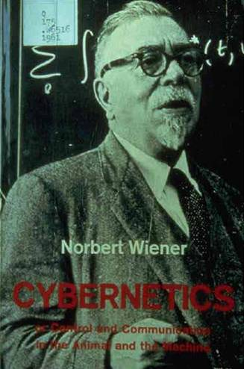
Norbert Wiener –Mathematician Cybernetics (1948)
Wiener believed that there were mathematical principles that explained human behavior
Systems that have goals
Using circular “feedback” loops of
sensing→comparing with goals →action → sensing …
Understand human interaction to design computer interaction
Notes:
13
These meetings, along with the 1948 publication of Norbert Wiener's book titled 'Cybernetics,' served to lay the groundwork for the development of cybernetics as we know it today.

Slide 14
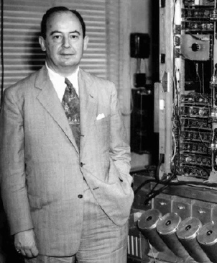
John von Neumann–Mathematician Inventor of Digital Computer (1952)
Implementation of Turing machine in digital hardware
Studies on complex automata made from unreliable parts
Quote from 1951
A new, essential logic, theory is called for in order to understand the high complexity automata and in particular the central nervous system. It may be however that in this process, logic will have to undergo a pseudomorphosis to neurology to a much greater extent than the reverse.
Notes:
14
These meetings, along with the 1948 publication of Norbert Wiener's book titled 'Cybernetics,' served to lay the groundwork for the development of cybernetics as we know it today.

Slide 15
Claude Shannon Electrical Eng. (1948)
Invented Information theory, so he is the father of the information age!
New branch of statistics
Optimal design of communication systems to achieve error bounds in arbitrary channels
Claude E. Shannon: A Mathematical Theory of Communication, Bell System Technical Journal, Vol. 27, pp. 379–423, 623–656, 1948.

Slide 16
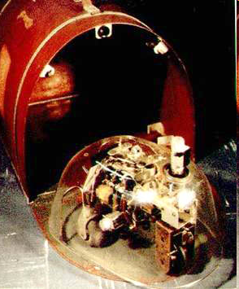
W.G. Walter Neurophysiologist and Roboticist (1950)
Neurologist who did computer analysis of EEG with Fourier analyzers
Bristol Turtoise, autonomous robots with sensors that would explore the environment and seek light to recharge their solar cell batteries
Seven postulates for autonomous behavior
Walter W.G. The living brain , 1953

Slide 17
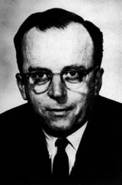
Jo C. R. Licklider Psychologist (1960)
Internet pioneer
Postulated “man-computer symbiosis”
Tightly coupling human brains and computing machines to revolutionize information handling
Concept of a “dialogue” and “partnership”
Licklider, J. C. R., Man-computer symbiosis, IRE Transactions on Human Factors in Electronics, HFE-1, 1960, 4-11.

Slide 18
Frank Rosenblatt Psychologist (1956)
Invented the Perceptron,
The first learning machine that could generalize
Proof of convergence
Rosenblatt F., Principles of Neurodynamics: Perceptrons and the Theory of Brain Mechanisms", Spartan Books 1962.

Slide 19
Donald O. Hebb Psychologist (1949)
Propose the Hebbian learning rule, for synaptic plasticity
Still the only widely accepted learning rule in computational neuroscience
Hebb, D. O. (1949). The Organization of Behavior: A Neuropsychological Theory. New York: Wiley and Sons.

Slide 20
Marvin Minsky Cognitive Scientist
One of the pioneers of Artificial Intelligence
Interested in Expert Systems
Very influential in AI
Papert, Seymour; Minsky, Marvin Lee (1988). Perceptrons: an introduction to computational geometry.
Cambridge, Massachusetts: MIT Press.
Minsky, Marvin Lee (1986). The Society of Mind. New York: Simon and Schuster.

Slide 21
Bernard Widrow Electrical Engineer
Inventor of the LMS (least mean square) algorithm and the father of adaptive signal processing.
Widely applied in modems (channel equalization)
Work on ADALINE
1985 B. Widrow and S. D. Stearns. Adaptive Signal Processing. New Jersey: Prentice-Hall, Inc., 1985.
1994 B. Widrow and E. Walach. Adaptive Inverse Control. New Jersey: Prentice-Hall, Inc., 1994.

Slide 22
Stephen Grossberg Computational Neuroscience
Early contributor in neurodynamics,
Very influential – EiC of Neural Networks, founder of International Neural Network Society
Propose the Adaptive Resonance Theory for unsupervised learning

Slide 23
Kunihiko Fukushima Computer Scientist
proposed the NeoCognitron, 1980
Very influential because it was a deep architecture (precursor to CNNs) that was trained in a supervised/unsupervised manner
Fukushima, Neocognitron (1980). "A self-organizing neural network model for a mechanism of pattern recognition
unaffected by shift in position". Biological Cybernetics. 36 (4): 193–202.

Slide 24
Paul Werbos Econometrics
Inventor of the Backpropagation through time algorithm to adapt recurrent networks,
Very influential figure at NSF to fund neural network research
Werbos, P. (1990). "Backpropagation Through Time: What It Does and How to Do It".
Proceedings of the IEEE. 78 (10): 1550–1560.

Slide 25
David Rumelhart Psychologist
One of the proponents of the backpropagation algorithm,
Very influential proponent of the parallel distributed processing in cognitive science
Rumelhart, David E.; Hinton, Geoffrey E.; Williams, Ronald J. (1986-10-09). "Learning representations by
back-propagating errors". Nature. 323 (6088): 533–536

Slide 26
Jeoffrey Hinton Computer Scientist
Co-inventor of the backpropagation algorithm.
Boltzmann machines
Very influential (postdocs, ph.d.) and the godfather of deep learning
Ackley, David H; Hinton Geoffrey E; Sejnowski, Terrence J (1985),
"A learning algorithm for Boltzmann machines", Cognitive Science, 9 (1): 147–169

Slide 27
Teuvo Kohonen Electrical Engineer
Early contributor to associative memories
Developed the learning vector quantization algorithm
Proponent of the Self Organizing Map
Kohonen, Teuvo (1982). "Self-Organized Formation of Topologically Correct Feature Maps".
Biological Cybernetics. 43 (1): 59–69.

Slide 28
Michael I. Jordan Psychology & Statistician
Early contributor, in artificial recurrent networks
Very influential computer scientist
Jacobs, R. A.; Jordan, M. I.; Nowlan, S. J.; Hinton, G. E. (1991). "Adaptive Mixtures of Local Experts".
Neural Computation. 3: 79–87.
David M. Blei, Andrew Y. Ng, Michael I. Jordan. Latent Dirichlet allocation.
The Journal of Machine Learning Research, Volume 3, 3/1/2003

Slide 29
Vladimir Vapnik Statistician
Very influential work on a new form of statistical learning called Structural Risk Minimization
Inventor of the support vector machine (SVM)
Vladimir Vapnik, The Nature of Statistical Learning Theory, Springer.
Cortes, Corinna; Vapnik, Vladimir (1995-09-01). "Support-vector networks". Machine Learning. 20 (3): 273–297.

Slide 30
Yiann Lecun Computer Scientist
Earlier contributor to neural networks
A major proponent of Deep Learning
Very influential (postdocs, ph.d.)
Developed the Convolution Neural Network
Chief AI Scientist at Facebook
Y. LeCun, B. Boser, J. S. Denker, D. Henderson, R. E. Howard, W. Hubbard and L. D. Jackel: Backpropagation
Applied to Handwritten Zip Code Recognition, Neural Computation, 1(4):541-551, Winter 1989.

Slide 31
Jurgen Schmidhuber Computer Scientist
Early contributor in neural networks
Very influential (postdocs, ph.d.)
Inventor of the LSTM (long short-term memory)
Sepp Hochreiter; Jürgen Schmidhuber (1997). "Long short-term memory". Neural Computation. 9 (8): 1735–1780.

Slide 32
Cycles in Neural Network Research
How to manage expectations?
Deep Learning
LeCun, Bengio, Hinton
2015
Multilayer Perceptrons
Rumelhart, Hinton, Williams
1986
Rosenblatt
Perceptron
1956
Vapnik
SVMs
1992
Minsky
1969
Data availability
Computing power
Backpropagation
1961
M-P Neuron
1943

Slide 33
Explaining the last Upswing
The latest upswing was not caused by new theories: it was due to the availability of large data sets, fast computers and the interest of the AI industry.
Speech recognition and object recognition, both perception tasks, were unmet needs for over 50 years.
With large data sets and huge computer clusters Microsoft, Google, Baidu and Facebook using deep learning were able to crack these two big fields and will reap the beneficit.

Slide 34
Looking at the Future
The methodologies for speech and face recognition are well established, but still use unrealistic methods to solve the problem (supervised learning).
A general way to perceive the world using machine learning for autonomous robotics and commercial use is still lacking. I am sure it will come, but is not here today.
And for those of us that understand the cognitive brain, perception is the “easy piece”, so there is a long way to go.
So hype, once again, may kill the momentum.

Slide 35
Looking at the Future
In my research I am interested in man-machine symbiosis
The opposite of the popular press, which fears a point where machines can outperform our intelligence.
The goal is to emulate the human perception-action-cycle in machines and let them use our physiological data and intentions to help us solve the problems we face everyday.
We already have most of the pieces, but the architecture for software integration is lacking, and machine learning will be part of it.

Slide 36
Conclusions I
We are at a cross road in scientific methods: deductive reasoning gave us our current understanding of the world.
Machine learning is an inductive process, so there are few guarantees of performance in new data (look at the prognostic in the recent US election!).
Contrast this to engineering design (also an inductive process): understand from first principles what works, how systems fail, put pieces together, and create an envelope of performance.
Wigner E., 1960 “Unreasonable Effectiveness of Mathematics in the Natural Sciences”, Comm. on Pure and Applied Math. 13: 1–14
Hamming R., 1980 “Unreasonable Effectiveness of Mathematics”, The American Mathematical Monthly. 87 (2): 81–90
Pereira F., Norvig P., Halevy A., 2009 "The Unreasonable Effectiveness of Data", IEEE Intelligent Systems, vol. 24, no. , pp. 8-12

Slide 37
Conclusions II
Complexification of society and processes is here to stay
What matters is not the big data we collect but the information that the data contains.
Information is the key commodity for decision making because it has a practicality that data lacks.
Information Theory will have a leading role in the future because it quantifies uncertainty, and together with machine learning can lead to optimization of information content.
When we change the information flow in a complex system, we change the system, so this is also the best tool for management.
Principe J., Information Theoretic Learning, Springer Inf. Science and Statistics, 2010.

